Slide 1
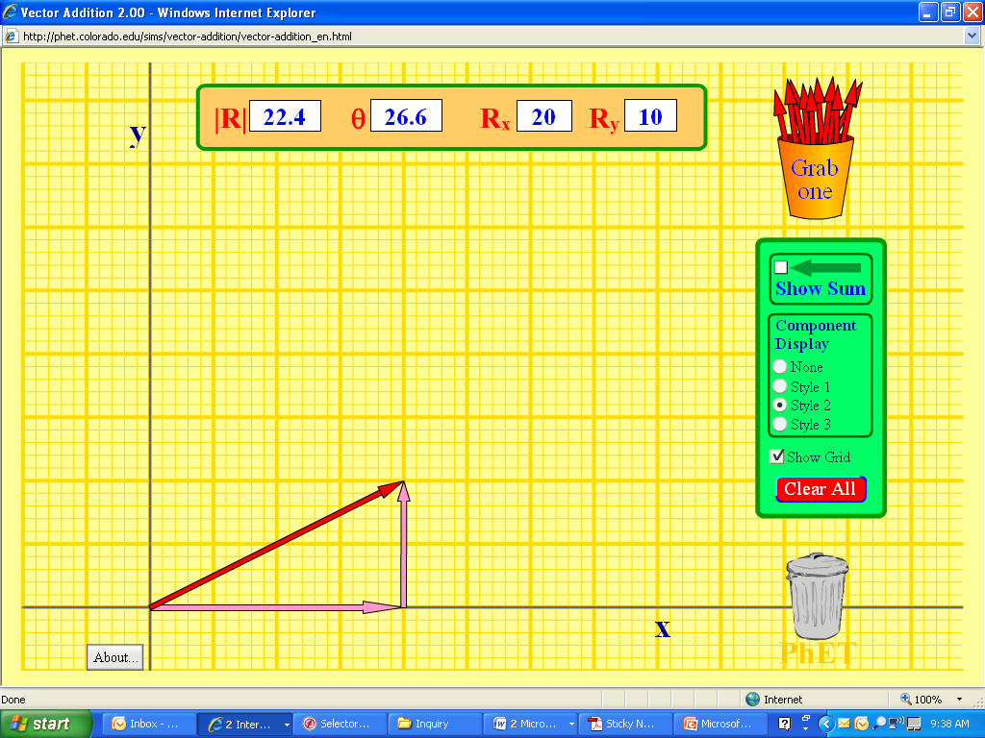
Please use Rx and R_{y} to find the length of the vector, R, and determine the angle, θ, with respect to the x-axis. Show your work on your PhET assignment
θ

Slide 2
Warm-Up 08/17/09
The human heartbeat, as determined by pulse rate, is normally about 60 beats per minute. If the heart pumps 75 mL of blood per beat, what volume of blood is pumped in one day in liters?

Slide 3
Warm-Up 08/19/09
1) Which of the following statements (hypotheses) could be tested as quantitative measurements? Explain
a) Jay Cutler is a better quarterback than Kyle Orton.
b) Tums consumes 35 times its weight in excess stomach acid.
c) The sample of gold is 99.85% pure.
2) A student performed an analysis of a sample for its copper content and got the following results:
35.23% 35.19% 35.22% 35.21% 35.20%
The actual amount of the copper in the sample is 33.22%. What conclusion can you draw about the accuracy and precision of these results? Explain.
3) How many how many milliliters are in 73 cubic meters?

Slide 4
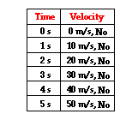
Describing Motion
Speed = Distance/Time
Velocity = Change in Position/Time
Acceleration = Change in Velocity/Time
Acceleration is a vector quantity which is defined as the rate at which an object changes its velocity. An object is accelerating if it is changing its velocity.

Slide 5
Construct a Graph to Represent the Change in Velocity Over Time
Constant acceleration – velocity changes by a constant amount each second.
•Change in speed •Change in direction
Direction of the Acceleration Vector
Acceleration is a vector quantity The direction depends on two things:
1) whether the object is speeding
up or slowing down
2) whether the object is moving in
the + or – direction

Slide 6
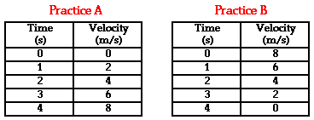
Example 1: Use the equation for acceleration to determine the acceleration for the following two motions
Notes:
Practice A Answer: a = 2 m/s/s
Use a = (v_{f} - v_{i}) / t and pick any two points.
a = (8 m/s - 0 m/s) / (4 s) a = (8 m/s) / (4 s)
a = 2 m/s/s
Practice B
Answer: a = -2 m/s/s
Use a = (v_{f}-v_{i}) / t and pick any two points.
a = (0 m/s - 8 m/s) / (4 s) a = (-8 m/s) / (4 s)
a = -2 m/s/s

Slide 7
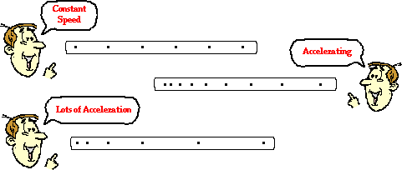
Describing Motion with Diagrams
Ticker-Tape Diagrams: The distance between dots on a ticker tape represents the object's position change during that time interval.
A changing distance between dots indicates a changing velocity or acceleration.

Slide 8
Example 3: Draw a vector diagram to represent the velocity of the car shown below. Use a different color to describe the acceleration of the car with a vector diagram. Trip A Trip B

Slide 9
Describing Motion with Position v Time Graphs
Time is always on the x-axis (it continues at a constant rate no matter what the speed is unless approaching the speed of light).
Plot the position along the y-axis
Graph the position of the car in the previous examples in two separate position v time graphs

Slide 10
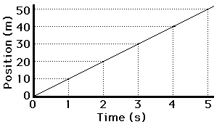
Trip A
What is the meaning of the slope on a position v time graph?
Slope = ∆y/ ∆x or rise/run
Notes:
The slope equation says that the slope of a line is found by determining the amount of rise of the line between any two points divided by the amount of run of the line between the same two points. In other words,
Pick two points on the line and determine their coordinates.
Determine the difference in y-coordinates of these two points (rise).
Determine the difference in x-coordinates for these two points (run).
Divide the difference in y-coordinates by the difference in x-coordinates (rise/run or slope).

Slide 11
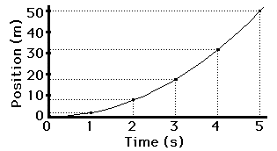
Trip B
Describe the slope
Construct another graph to show velocity v time

Slide 12
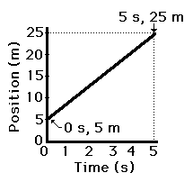
Example 4: Determine the velocity (i.e., slope) of the object as portrayed by the graph below.
Notes:
The velocity (i.e., slope) is 4 m/s. If you think the slope is 5 m/s, then you're making a common mistake. You are picking one point (probably 5 s, 25 m) and dividing y/x. Instead you must pick two points (as discussed in this part of the lesson) and divide the change in y by the change in x.

Slide 13
Example 5: Consider the graph at the right. The object whose motion is represented by this graph is ... (indicate whether it is true or false and explain why):
moving in the positive direction.
moving with a constant velocity.
moving with a negative velocity.
slowing down.
changing directions.
speeding up.
moving with a positive acceleration.
moving with a constant acceleration.
Notes:
Answers: a, d and h apply.
a: TRUE since the line is in the positive region of the graph.
b. FALSE since there is an acceleration (i.e., a changing velocity).
c. FALSE since a negative velocity would be a line in the negative region (i.e., below the horizontal axis).
d. TRUE since the line is approaching the 0-velocity level (the x-axis).
e. FALSE since the line never crosses the axis.
f. FALSE since the line is not moving away from x-axis.
g. FALSE since the line has a negative or downward slope.
h. TRUE since the line is straight (i.e, has a constant slope).

Slide 14
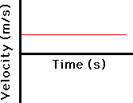
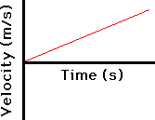
The Shape of Velocity v Time Graphs
Constant Velocity
Changing Velocity

Slide 15
The Meaning of Slope Velocity v Time Graphs
How can you tell whether the object is moving in the positive direction (i.e., positive velocity) or in the negative direction (i.e., negative velocity)?
How can you tell if the object is speeding up or slowing down?

Slide 16
How can you tell whether the object is moving in the positive direction (i.e., positive velocity) or in the negative direction (i.e., negative velocity)?

Slide 17
How can you tell whether the object is moving in the positive direction (i.e., positive velocity) or in the negative direction (i.e., negative velocity)?

Slide 18
How can you tell if the object is speeding up or slowing down?

Slide 19
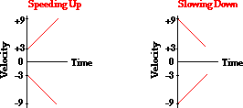
How can you tell if the object is speeding up or slowing down?

Slide 20
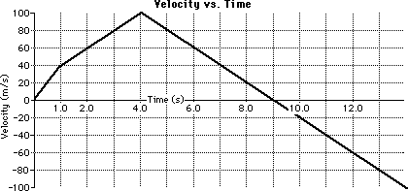
Example 6: The velocity-time graph for a two-stage rocket is shown below. Use the graph and your understanding of slope calculations to determine the acceleration of the rocket during the listed time intervals.
t = 0 - 1 second
t = 1 - 4 second
t = 4 - 12 second
Notes:
The acceleration is +40 m/s/s. The acceleration is found from a slope calculation. The line rises +40 m/s for every 1 second of run.
The acceleration is +20 m/s/s. The acceleration is found from a slope calculation. The line rises +60 m/s for 3 seconds of run. The rise/run ratio is +20 m/s/s.
The acceleration is -20 m/s/s. The acceleration is found from a slope calculation. The line rises -160 m/s for 8 seconds of run. The rise/run ratio is -20 m/s/s.

Slide 21
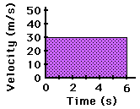
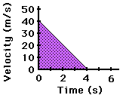
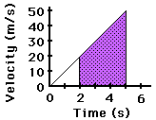
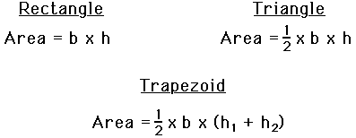
Area in Velocity v Time Graphs
For velocity versus time graphs, the area bound by the line and the axes represents the displacement

Slide 22
Independent Practice: Remember, homework is work to be done at HOME by YOU!
Homework: p. 58-60; 9, 11, 12, 15, 19, 20, 32, 33, 38, 40, 41, 42,

Slide 23
48, 49, 53, 86, 87, 92, 96, 99

