Slide 1
Moving Electricity – Electrical Circuits and Current

Slide 2
Bellwork Charge Q acts as a point charge to create an electric field. Its strength, measured a distance of 30 cm away, is 40 N/C. What is the magnitude of the electric field strength that you would expect to be measured at a distance of ...
60 cm away?
15 cm away?
90 cm away?
3 cm away?
45 cm away?
Notes:
Answers: a) 10 N/C, b) 160 N/C, c) 4.4 N/C, d) 4000 N/C, e)17.8 N/C
The electric field strength is inversely related to the square of the distance. So by whatever factor d changes by, the E value is altered in the inverse direction by the square of that factor. The specifics are as follows:
a) d increases by a factor of 2; divide the original E by 4. b) d decreases by a factor of 2; multiply the original E by 4.
c) d increases by a factor of 3; divide the original E by 9.
d) d decreases by a factor of 10; multiply the original E by 100.
e) d increases by a factor of 1.5; divide the original E by (1.5)².

Slide 3
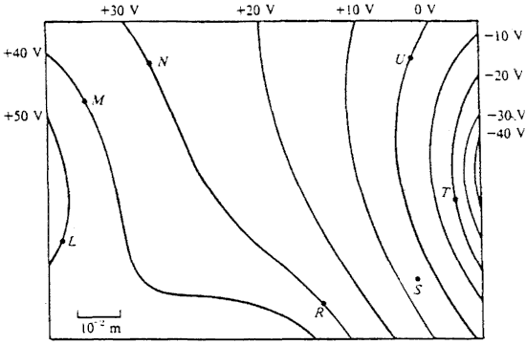
1.Where is the electric field strongest?
2. Where is the electric field weakest?
3. What is the direction of the electric field at R?
L
M
N
R
S
T
U
East
West
North
South
Northeast
Southeast
Nowhere

Slide 4
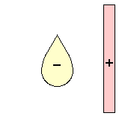
Diagram the electric field lines for the following configuration of two objects. Place arrows on your field lines.
-
+
Notes:
Electric Field Line Diagram for Question #5:
Once more, the above diagram was not created by a Field Plotting software program; it would likely look better if it had been. Your answer may look different (especially when the details are compared) but it should share the following general characteristics with the diagram given here:
The field lines should be directed from + to - or from the edge of the page to the - or from + to the edge of the page. Each field line MUST have an arrowhead on it to indicate such directions.
At the surface of either object, the field lines should be directed perpendicular to the surface.
There should be more lines at the sharply curved and pointed surfaces of the objects and less lines at the flatter sections.

Slide 5
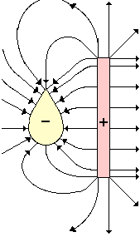
Solution – Field lines are perpendicular to the surface and point from the positive to the negative – Please turn the arrows around on the right hand side!
-
+

Slide 6
Electrical Potential
Stored energy is potential energy
The total energy of a system is conserved, so a change in potential results in movement of electrons, or a change in kinetic energy
Voltage is a measure of electric potential difference in units of Volts
1V = 1Joule/1 Coulomb

Slide 7
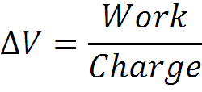
Electric Potential Difference
Consider of moving a positive test charge in an electric field from location A to location B as shown in the diagram.
Work will have to be done on the charge by an external force to change its potential energy to a higher value.

Slide 8
Example Problems
Moving an electron within an electric field would change the ____ the electron.
mass of
amount of charge on
potential energy of
2. The electron would naturally tend to move ______.
From an area of high potential to an area of low potential
From an area of low potential to an area of high potential
Neither – it will not move at all

Slide 9
The following circuit consist of a D-cell and a light bulb. Use >, <, and = symbols to compare the electric potential at A to B and at C to D. Indicate whether the devices add energy to or remove energy from the charge.

Slide 10
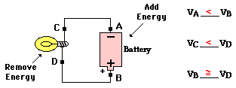
The battery adds energy to the charge to move it from the low potential, negative terminal to the high potential, positive terminal. The light bulb removes energy from the charge.

Slide 11
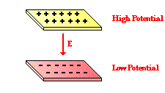
Capacitors
For a pair of charged
parallel plates, the positively
charged plate is at a higher electric potential than the negatively charged on by an amount ΔV
A Capacitor is a pair of charged plates that store electrical energy.
Examples: batteries, stun guns, heart defibrillators, body’s nervous system, X-ray machines, electrical appliances, computers, etc

Slide 12
Example Problem: In the movie Tango and Cash, Kurt Russell and Sylvester Stallone escape from a prison by jumping off the top of a tall wall through the air and onto a high-voltage power line. Before the jump, Stallone objects to the idea, telling Russell "We're going to fry." Russell responds with "You didn't take high school Physics did you. As long as you're only touching one wire and you're feet aren't touching the ground, you don't get electrocuted." Is this a correct statement?
Notes:
Answer: Yes!
In order for there to be a sustained flow of charge from one location to another, there must be a difference in electric potential. In this case, there would be a momentary flow of charge between the wire and the actor until they reach the same electric potential. Once at the same potential, charge flow would cease and there would be no electrocution. However, if the actor's feet touched the ground (an electric potential of 0) or another wire of a different potential, then there would be a sustained charge flow which likely would lead to electrocution.

Slide 13
An Elevated Water Tank Model for Electricity
Valve represents a resistor
Potential energy represents the voltage
Amount of flowing water represents the current
Notes:
The voltage is the potential energy of the top of the water in the tank in relation to the ground.
The current flow is the amount of water coming out of the hose connected to the tank.
Amount of flowing water represents the current
Valve represents a resistor
Potential energy represents the voltage
An Elevated Water Tank Model for Electricity
A resistor is a valve that lets more or less water pass through it.

Slide 14
Current – the rate of flow of net charge
Where I is current, q is electrical charge, and t is time in seconds, current is measured by
SI Unit of Current: Coulomb per second, C/s, or ampere, A (amps)

Slide 15
Example Problems
A 2 mm long cross section of wire is isolated and 20 C of charge are determined to pass through it in 40 s.
2. A 1 mm long cross section of wire is isolated and 2 C of charge are determined to pass through it in 0.5 s.
Notes:
1. A 2 mm long cross section of wire is isolated and 20 C of charge are determined to pass through it in 40 s.
Answer: I = Q / t = (20 C) / (40 s) = 0.50 Ampere
2. A 1 mm long cross section of wire is isolated and 2 C of charge are determined to pass through it in 0.5 s.
Answer: I = Q / t = (2 C) / (0.5 s) = 4.0 Ampere

Slide 16
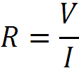
Resistance and Ohm’s Law
Any object that offers significant resistance to electrical current due to internal friction of moving electrons is a resistor
Ohm’s Law: V=IR
Measured in units of ohms, Ω, or volt per ampere

Slide 17
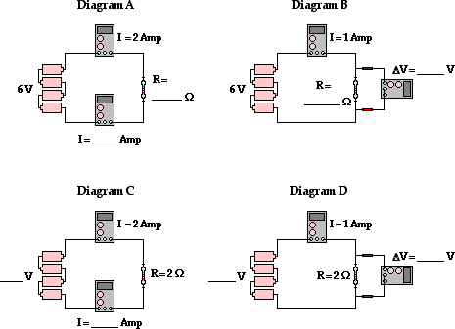
Use the Ohm's law equation to determine the missing values in the following circuits

Slide 18
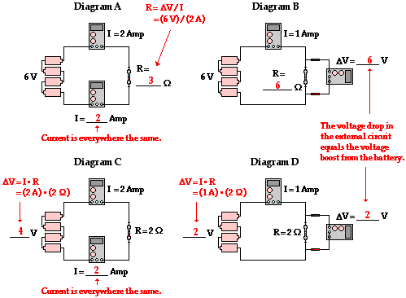

Slide 19
Resistance is the hindrance to the flow of charge.
First, the total length of the wires will affect the amount of resistance.
Second, the cross-sectional area of the wires will affect the amount of resistance.
Third, the material that a wire is made of will affect the amount of resistance. The conducting ability of a material is often indicated by its resistivity.
Notes:
The longer the wire, the more resistance that there will be. There is a direct relationship between the amount of resistance encountered by charge and the length of wire it must traverse. After all, if resistance occurs as the result of collisions between charge carriers and the atoms of the wire, then there is likely to be more collisions in a longer wire. More collisions means more resistance.
Wider wires have a greater cross-sectional area. Water will flow through a wider pipe at a higher rate than it will flow through a narrow pipe. This can be attributed to the lower amount of resistance which is present in the wider pipe. In the same manner, the wider the wire, the less resistance that there will be to the flow of electric charge. When all other variables are the same, charge will flow at higher rates through wider wires with greater cross-sectional areas than through thinner wires.
Not all materials are created equal in terms of their conductive ability. Some materials are better conductors than others and offer less resistance to the flow of charge. Silver is one of the best conductors but is never used in wires of household circuits due to its cost. Copper and aluminum are among the least expensive materials with suitable conducting ability to permit their use in wires of household circuits. The conducting ability of a material is often indicated by its resistivity. The resistivity of a material is dependent upon the material's electronic structure and its temperature.

Slide 20
Material | Resistivity (ohm•meter)
Silver | 1.59 x 10⁻⁸
Copper | 1.7 x 10⁻⁸
Gold | 2.4 x 10⁻⁸
Aluminum | 2.8 x 10⁻⁸
Tungsten | 5.6 x 10⁻⁸
Iron | 10 x 10⁻⁸
Platinum | 11 x 10⁻⁸
Lead | 22 x 10⁻⁸
Nichrome | 150 x 10⁻⁸
Carbon | 3.5 x 10⁵
Polystyrene | 10⁷ - 10¹¹
Polyethylene | 10⁸ - 10⁹
Glass | 10¹⁰ - 10¹⁴
Hard Rubber | 10¹³

Slide 21
Relationship between Resistance and Type of Wire
Resistance (R) of a cylindrically shaped conductor (e.g., a wire) is directly proportional to the length of the wire (in meters), L, and the resistivity of the material (in ohm•meter), ρ, but inversely proportional to the cross-sectional area of the wire (in meters²), A.

Slide 22
Household circuits are often wired with two different widths of wires: 12-gauge and 14-gauge. The 12-gauge wire has a diameter of 1/12 inch while the 14-gauge wire has a diameter of 1/14 inch. Thus, 12-gauge wire has a wider cross section than 14-gauge wire. A 20-Amp circuit used for wall receptacles should be wired using 12-gauge wire and a 15-Amp circuit used for lighting and fan circuits should be wired using 14-gauge wire. Explain the physics behind such an electrical code.

Slide 23
Answer
A 12-gauge wire is wider than 14-gauge wire and thus has less resistance. The lesser resistance of 12-gauge wire means that it can allow charge to flow through it at a greater rate - that is, allow a larger current. Thus, 12-gauge wire is used in circuits which are protected by 20-Amp fuses and circuit breakers. On the other hand, the thinner 14-gauge wire can support less current owing to its larger resistance; it is used in circuits which are protected by 15-Amp fuses and circuit breakers.

Slide 24
2. Based on the information stated in the above question, explain the risk involved in using 14-gauge wire in a circuit that will be used to power an 16-ampere power saw.

Slide 25
3. Determine the resistance of a 1-mile length of 12-gauge copper wire. Given: 1 mile = 1609 meters and diameter = 0.2117 cm.

Slide 26
4. Two wires - A and B - with circular cross-sections have identical lengths and are made of the same material. Yet, wire A has four times the resistance of wire B. How many times greater is the diameter of wire B than wire A?

Slide 27
Independent Practice
Solve the Example Problems in your notes to turn in Tuesday
P. 562- 563 ; 7, 8, 10, 18
P. 586-587 ; 9, 10, 19, 20, 22, (26*Bonus*), 38, 39, 40,

Slide 28
Warm Up
Use one battery, one wire, and one light bulb to create a circuit that turns the light on. Sketch all the possible ways to connect them.
Work with your best partner to make a circuit with two batteries, two wires, and two light bulbs. Sketch all the possible ways to make BOTH lights turn on .
As a team, use all your materials to make ALL the lights turn on.

